Slide 1
BHARATHI WOMEN’S COLLEGE(AUTONOMOUS) CHENNAI-600108 JOB APPLICATION AND TRACKING SYSTEM
REG NO | NAME | EMAIL
TEAM LEADER
2013331072004 | GUNASUNDARI.S | skavitha.guna@gmail.com
TEAM MEMBERS
2013331072001 | ABIRAMI.V | abiabiramii2327@gmail.com
2013331072002 | ANBARASI.R | ranbarasi05@gmail.com
2013331072003 | ELAKKIYA.D | elakkiya1062003@gmail.com

Slide 2
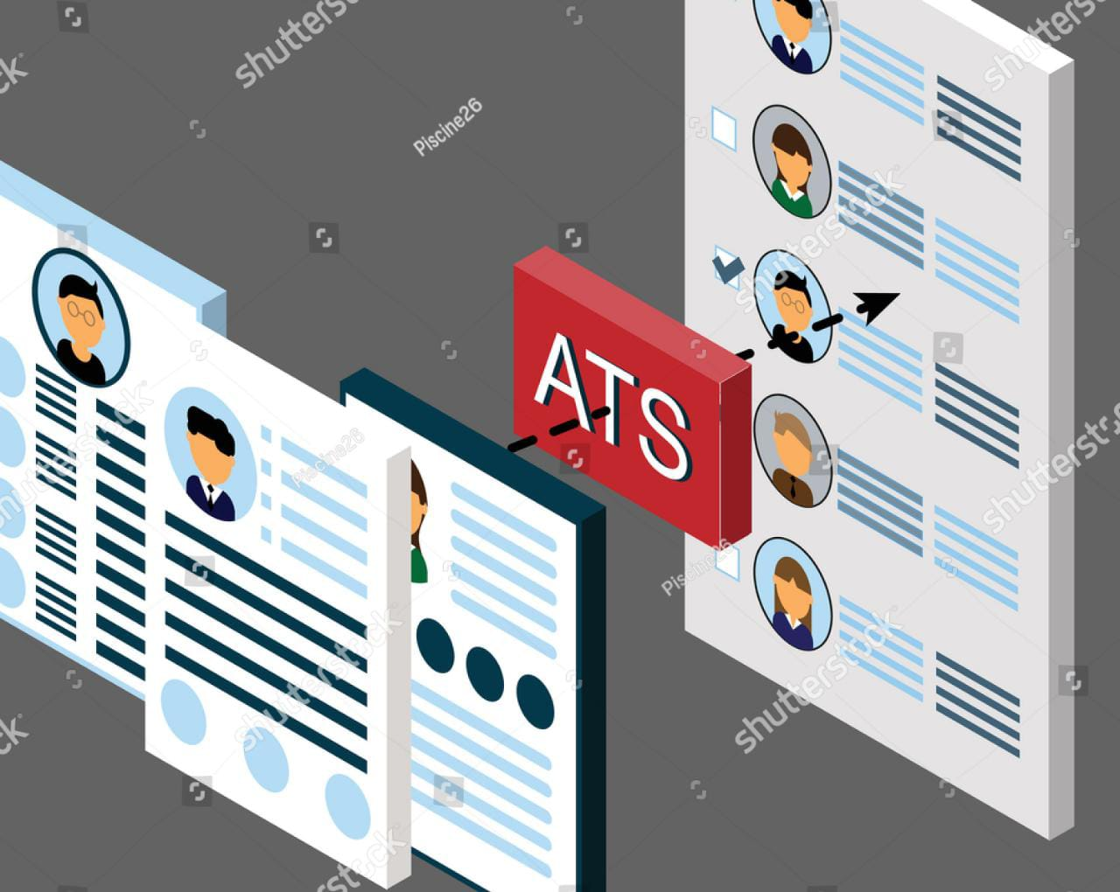
job application and tracking system

Slide 3
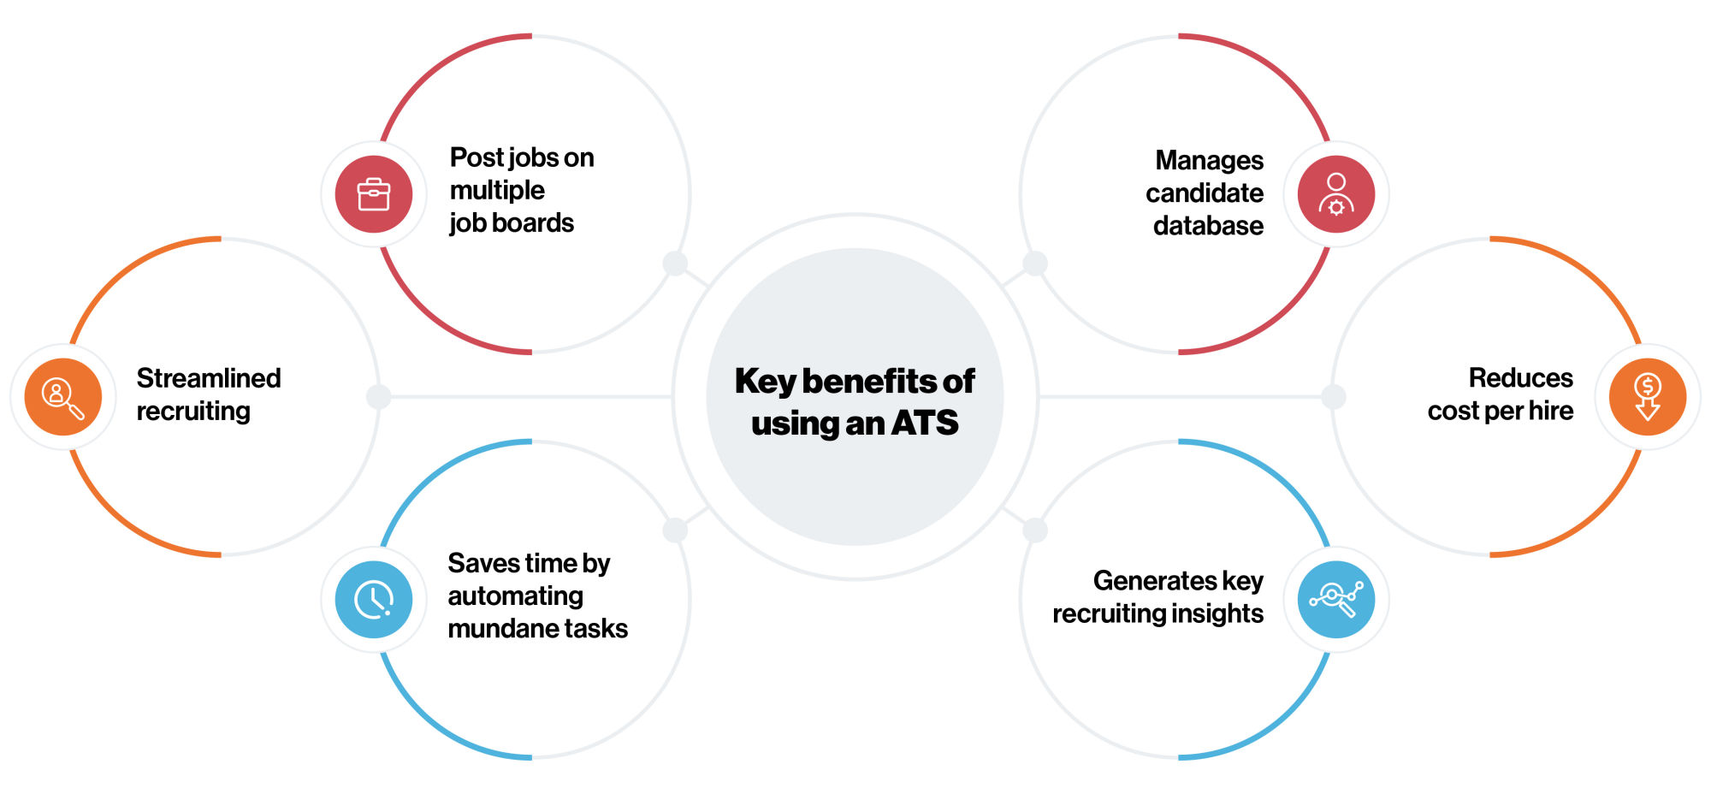
INTRODUCTION
Overview
Purpose
Create a CRM Application which helps the applicant to track the No. of jobs he applied and helps him to find the job posted by the various recruiters, find the best attributes to be involved to run the process in a smooth way and easily to track.

Slide 4
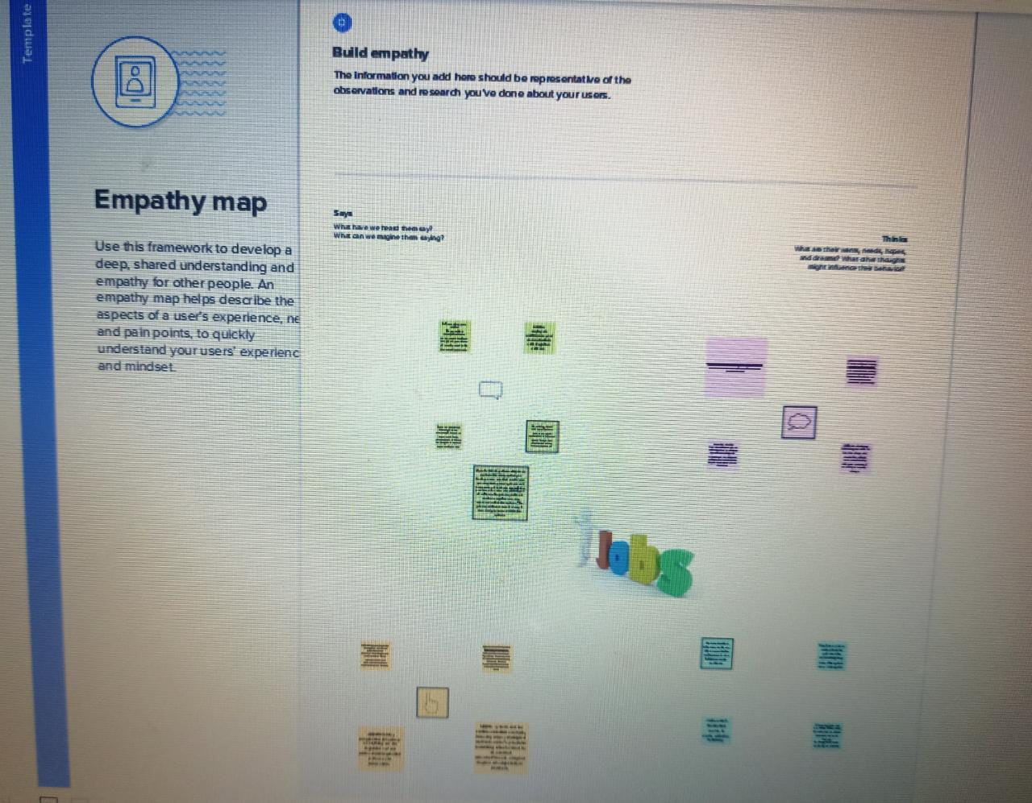
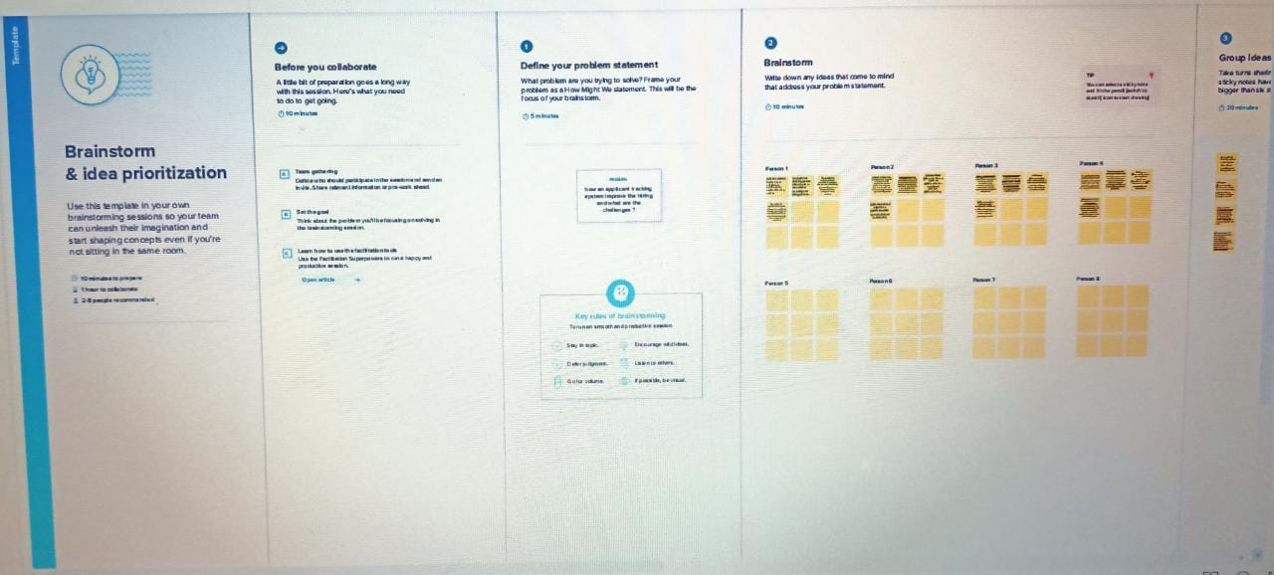
PROBLEM DEFINITION AND DESIGN THINKING:
EMPATHY MAP
IDEATION & BRAINSTORMING MAP

Slide 5
RESULT DATA MODEL:
object name | field in the object
 | field label | data type
object 1 | recruiter | auto number
 | length | text
object 2 | location | text area
 | canditate | text

Slide 6
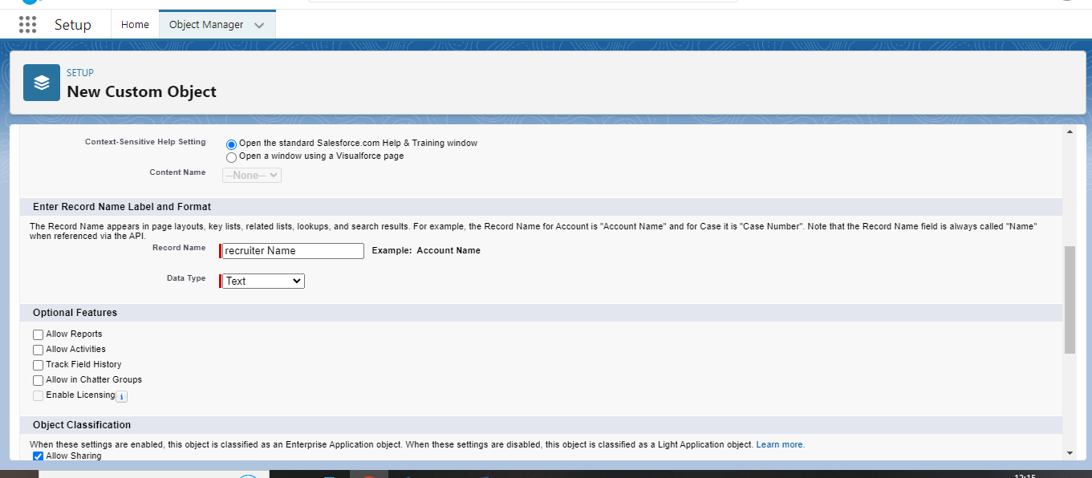
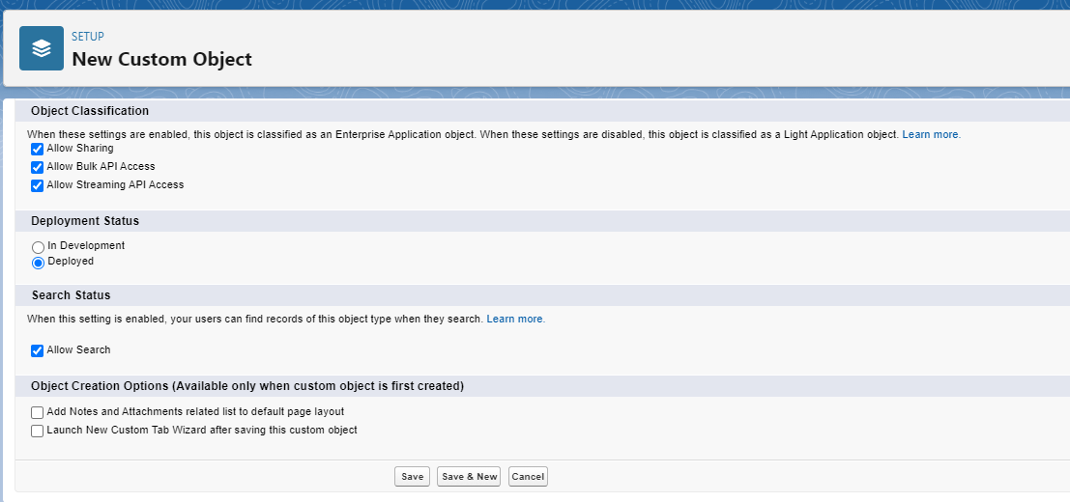
new custom object
object

Slide 7
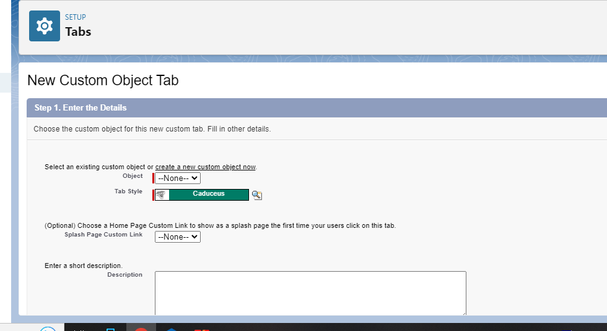
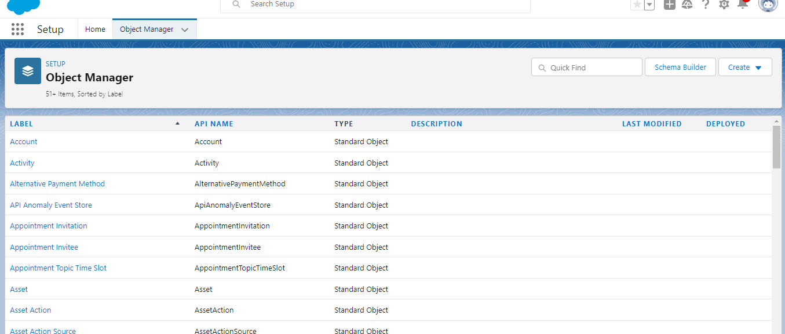
NEW CUSTOM OBJECT FIELD
OBJECT MANAGER

Slide 8
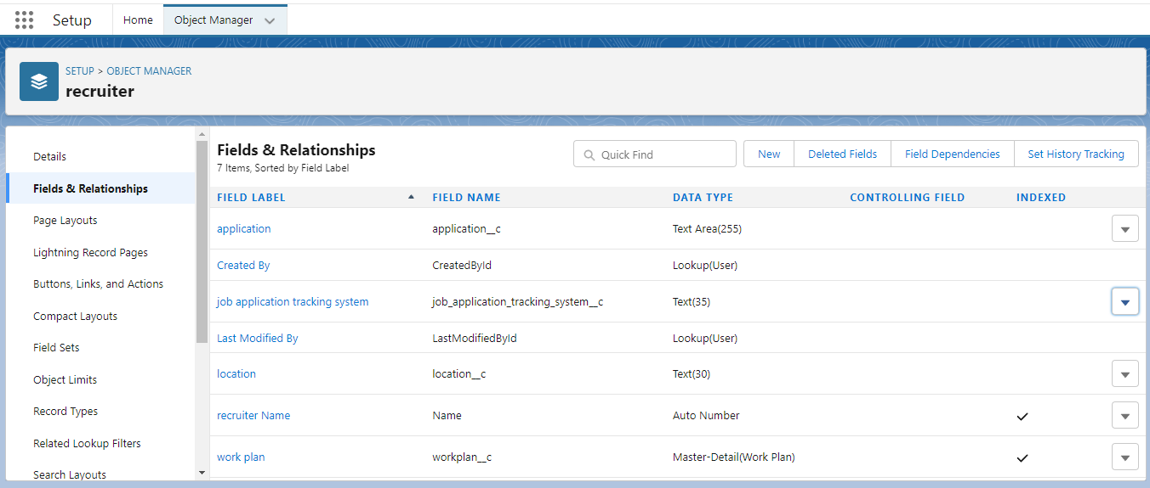
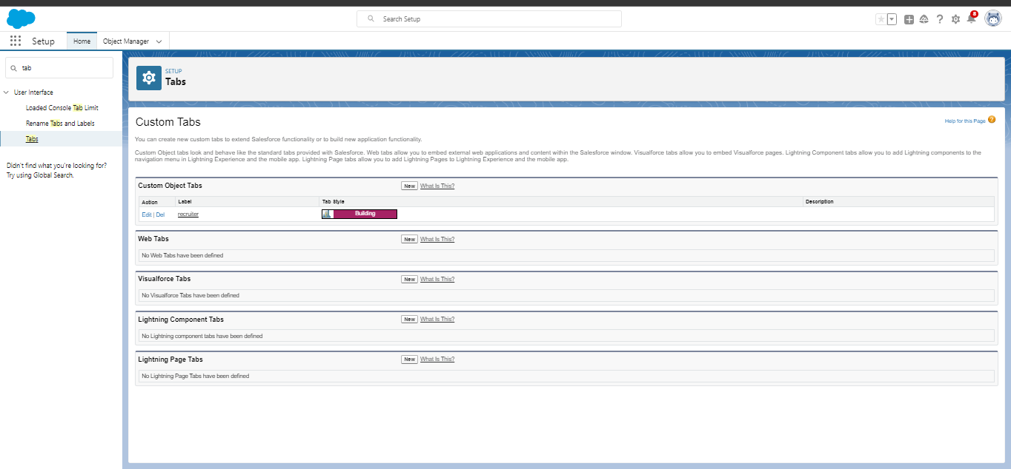
FIELD
TABS

Slide 9
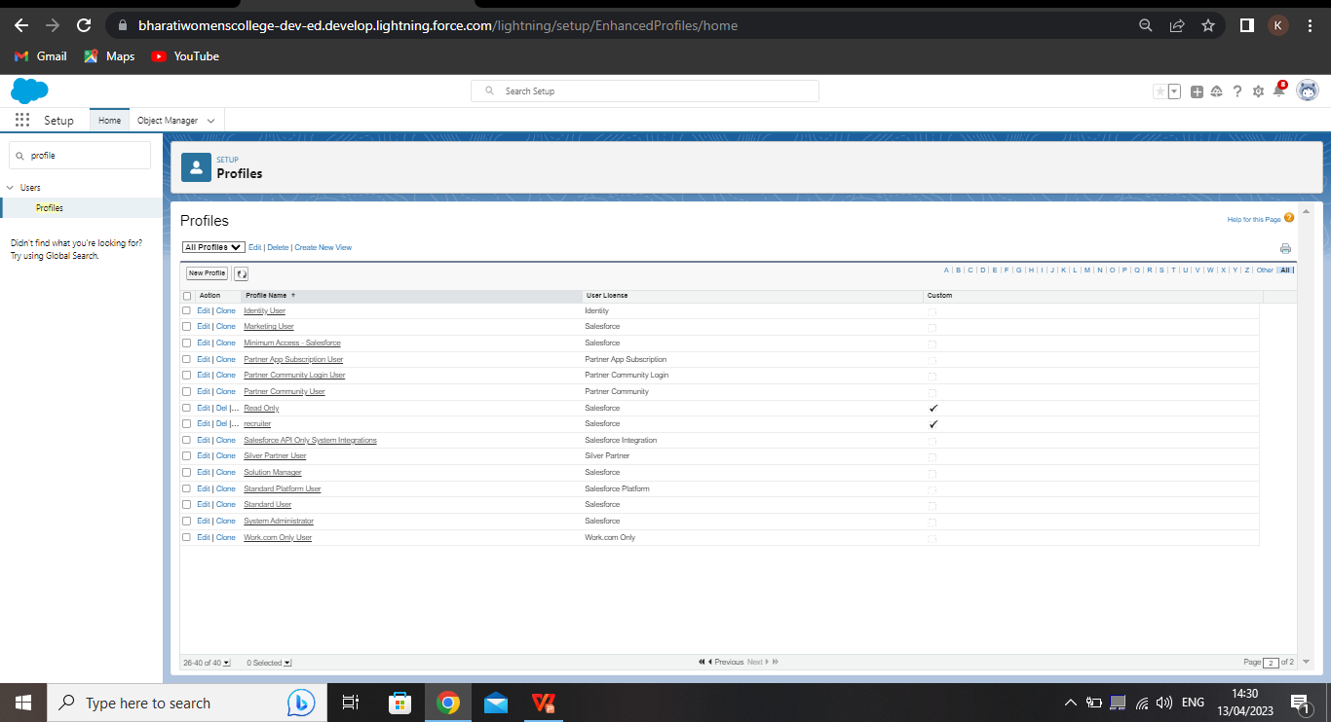
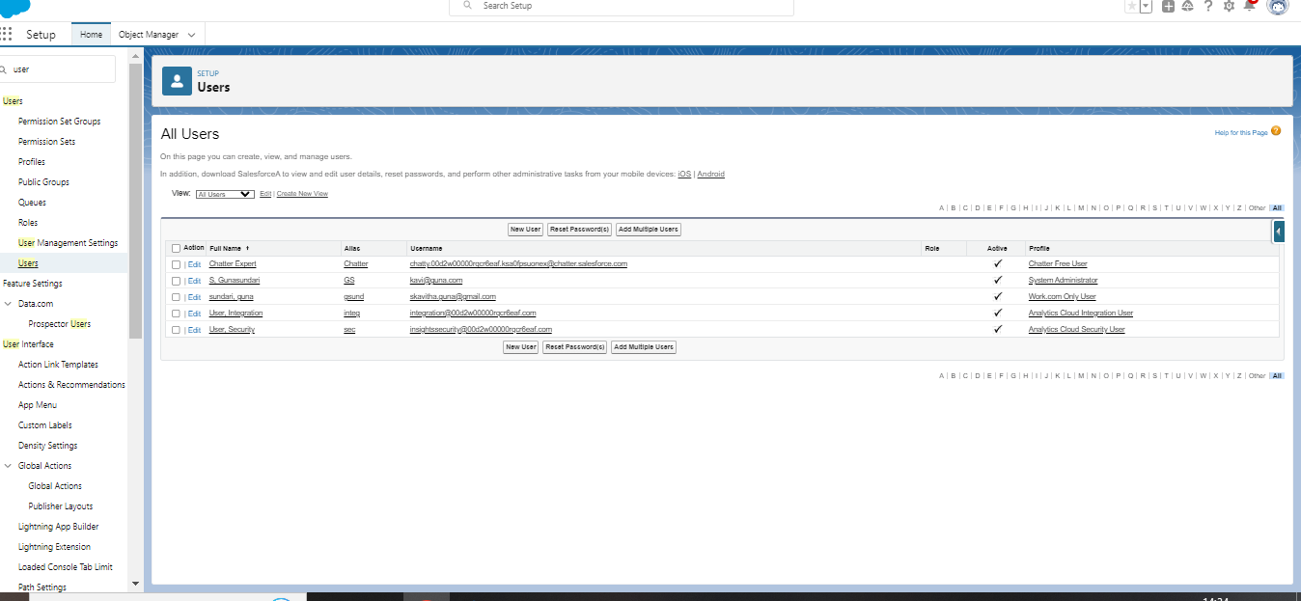
PROFILE
USERS

Slide 10
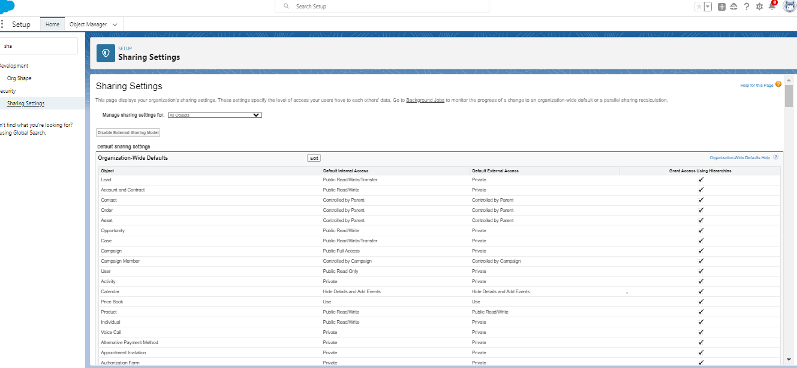
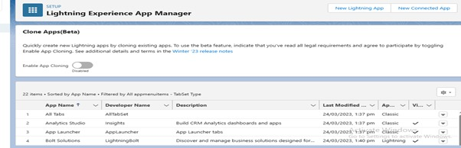
PERMISSION SET
LIGHTNING EXPERIENCE APP MANAGER

Slide 11
TRAILHEAD PROFILE PUBLC URL:
TEAM LEADER (GUNASUNDARI.S) -https://trailblazer.me/id/gunas72
TEAM MEMBER 1 (ABIRAMI.V) -https://trailblazer.me/id/aabirami4
TEAM MEMBER 2 (ANBARASI.R) -https://trailblazer.me/id/anbar18
TEAM MEMBER 3 (ELAKKIYA.D) -https://trailblazer.me/id/elakd

Slide 12
ADVANTAGES AND DISADVANTAGES
ADVANTAGES
DISADVANTAGES
Improves onboarding. As an extension of the recruiting process, onboarding can be streamlined as well. Once you find the right candidate, you want to onboard them as quickly as possible so they can focus on improving your business Reduces time spent on admin tasks. ATS software allows you to automate various tasks of the hiring process that can save you a lot of time and free up your recruiting personnel for other high-value tasks. Posting to multiple job boards, tracking candidate applications, notifying candidates individually, and scheduling interview feedback can all be automated.
Could filter out good candidates. When “programming” your recruiting software to recognize common keywords around roles and responsibilities, you could end up filtering out good candidates that have atypical experience or lack keywords that are aligned with what you are looking . Communications can be less personalized. When automating responses to candidates, your messaging will be less personalized and can come off as robotic. Taking additional time to construct good communication can make it feel more personalized. It’s much better to send a less personalized communication than no communication at allam] Pattu: Communications can be less personalized. When automating responses to candidates, your messaging will be less personalized and can come off as robotic. Taking additional time to construct good communication can help make it feel more personalized. It’s much better to send a less personalized communication than no communication at all

Slide 13
APPLICATION
One of the biggest recruiting challenges involves too much paperwork. This ATS solution enables you to have all of your passive and active candidates and applicants in one single talent pool.
Sourced candidates, referrals, applicants from job boards, social media platforms, career sites will all be in one place. Get rid of papers and spreadsheets, and enjoy a more organized way to manage your candidate and applicant pool.

Slide 14

CONCLUSION
Applicant Tracking System for recruiters is a very effective hiring solution that most of the successful recruiters utilize. Because without it, there is a good chance that your process of moving applicants through different stages can become very difficult.

Slide 15

FUTURE SCOPE
An ATS creates opportunities to automate manual processes, increase visibility into the hiring cycle for the entire recruiting team, and increase opportunities for communication throughout the candidate journey. 78% of recruiters using an ATS report that it has improved the quality of the candidates they hire.

Slide 16

DONE BY;
s.Guna sundari
v.Abirami
R.Anbarsi
D.Elakkiya

